Slide 1

Beverage company Performance Insights
Muhammad Satrio Pamungkas Suharoyo

Slide 2
Beverage Company Background
The company (established just 5 years ago), has already experienced rapid growth.
In 2016, its sales nearly reached 5 million dollars.
The Beverage Company's stores are spread across 80 locations.
Offers a unique and diverse range of products that define their distinctive identity.

Slide 3
Business Processes
The Beverage Company purchases goods from vendors
The purchased goods from the vendors are delivered to the Beverage Company's store
The buying and selling process to customers occurs at each store
The vendor also provides delivery services

Slide 4

THE MANAGEMENT HAS REQUESTED AN ANALYSIS OF THE COMPANY'S PERFORMANCE

Slide 5
Table of Content
Goals and List of Provided Data
Beverage Company: Logistic Insights
Beverage Company: Marketing Startegy and Product Development
Beverage Company: Managing Key Vendor
Conclusion and Recommendation

Slide 6
List of provided data from the Management
Beginning Inventory : List of inventory status at the beginning of Fiscal Year (2016)
Ending Inventory : List of inventory status at the end of Fiscal Year (2016)
Purchases : List of purchasing activities throughout the year (in 2016)
Sales : List of sales activities throughout the year (in 2016)

Slide 7
Goals
Verifying inventory items completeness
Analyzing company performance to focus on marketing strategies and product development
Identifying non-performing products
Determining key vendors for purchasing activity

Slide 8
Beverage company LOGISTIC Insights

Slide 9
Verify inventory items completeness using SQL
What needs to be checked is,
Ending Inventory = Beginning Inventory + Purchases – Sales

Slide 10
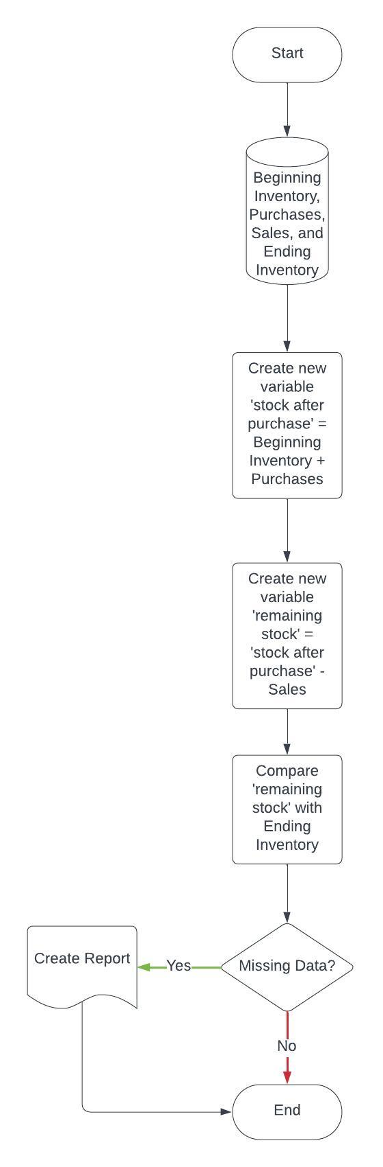
FRAME WORK SQL

Slide 11
Processing Data
Created a new variable called 'stock after purchase' by (Beginning Inventory + Purchases)
Created another new variable named 'remaining stock' by (‘stock after purchase’ – Sales)
Validated the data by comparing the 'remaining stock' with the Ending Inventory.
After the data has been processed, several errors were found.

Slide 12
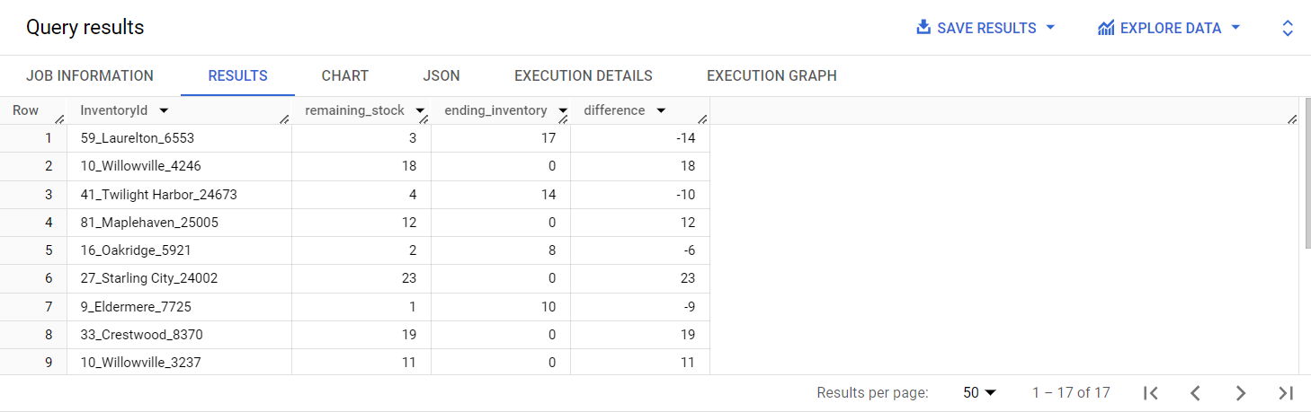
Findings-1
There is a discrepancy between the remaining stock variable and the ending inventory. There are 17 InventoryId with differing records in both tables
The data provided by the company at the end of the year (Ending Inventory) should ideally match with My calculation (Beginning Inventory + Purchases - Sales)
There should be no difference between remaining stock and ending inventory
InventoryId serves as the key to join the 4 existing tables. InventoryId is a code that consists of a combination of 'storenumber_city_brandnumber'.

Slide 13
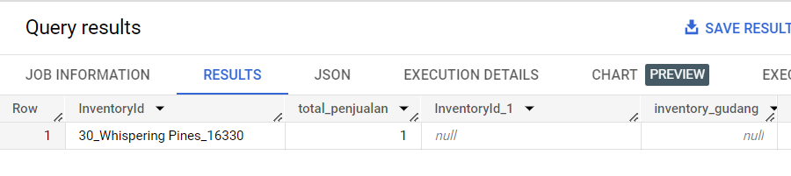
Findings-2
Sales
One InventoryId is present in the sales data, but it is missing from the 'stock after purchase' variable
This is not ideal in the company's business process. Because it is impossible for any product to be sold if it is not available in the stock warehouse
There is also a possibility that the item is the beginning-of-year stock or items purchased but not recorded
‘stock after purchase’

Slide 14
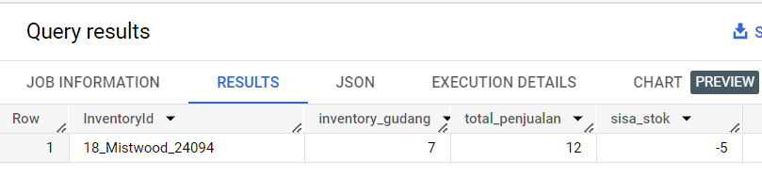
Findings-3
There is one InventoryId with a total sales figure that exceeds the total ‘stock after purchase’
This is not ideal in the company's business process. Because the total number of items sold should be equal to or less than the items available in the warehouse
There might be an error in recording sales data
There may also be double scanning at the cashier store
‘stock after purchase’
Sales
‘remaining stock’

Slide 15
About Findings
The Production, Distribution, and Sales teams need to be more meticulous in data recording and creating annual reports. Below are some inputs and corrections that can serve as future references:
During the initial inventory recording at the beginning of the year, there might be unrecorded items or old stock that went unnoticed.
When recording purchased items, purchases of quantity 1 are slightly more risky as they are prone to being overlooked. In my opinion, scheduling purchases to be less frequent might be necessary.
During sales record-keeping, it's essential to also pay attention at the cashier to check for double scans or instances where items are not scanned but taken by the customer.
Upon comparison, the remaining stock quantity (235) is larger than the Ending_Inventory (148). This indicates that the number of items in the annual report is less than the actual count, which could also serve as an operational evaluation for the future.

Slide 16
Beverage company marketing strategy & PRODUC DEVELOPMENT

Slide 17
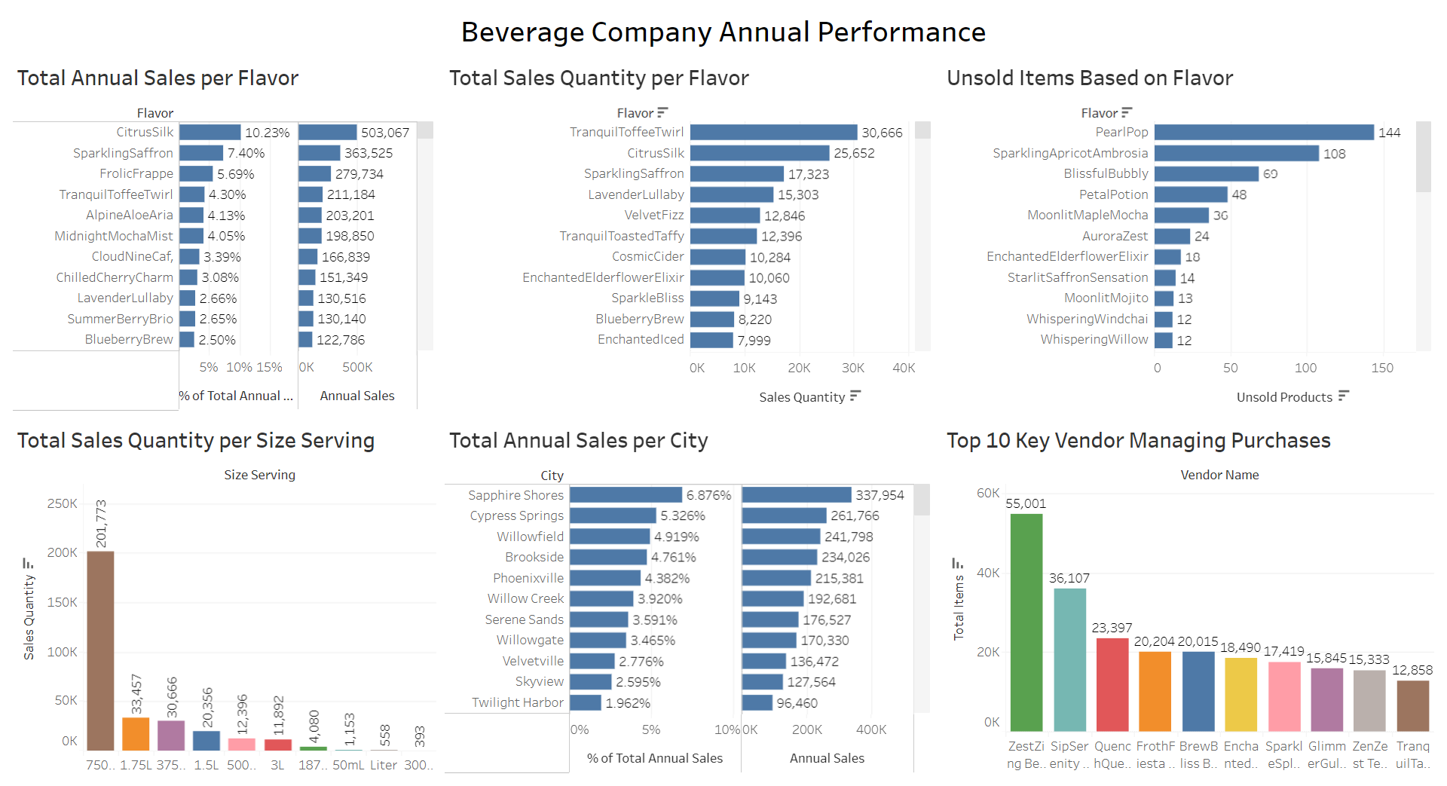

Slide 18
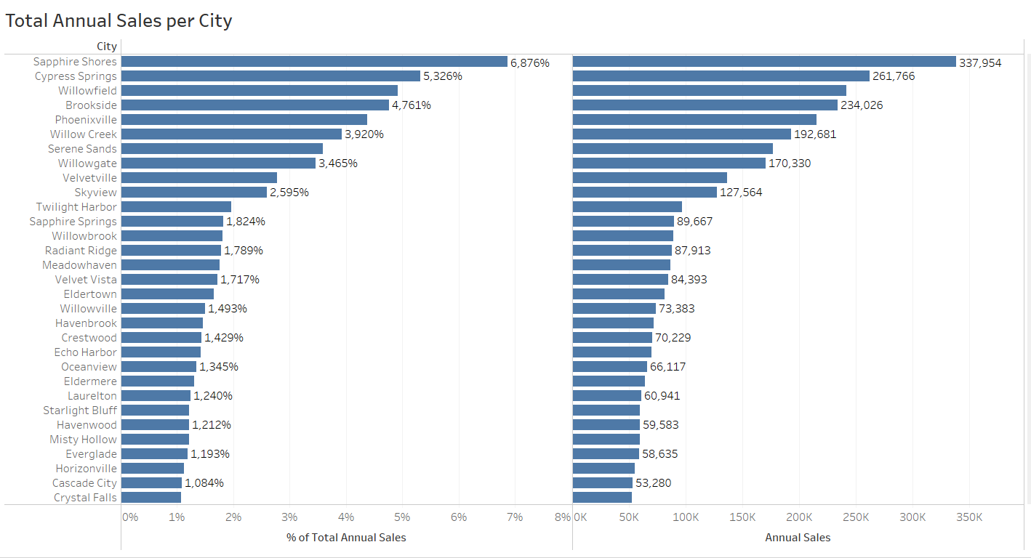
Annual Sales per City
The beverage company only has one store in each city
Stores 76, 73, and 38 make the largest contributions, accounting for 6.8%, 5.3%, and 4.9% of the total annual sales, respectively.
Marketing and supply of goods for the next year can be focused on these three stores.
These stores are located in Sapphire Shores, Cypress Springs, and Willowfield

Slide 19
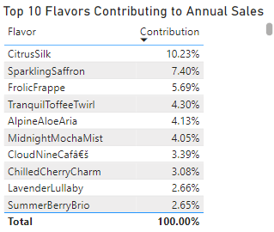
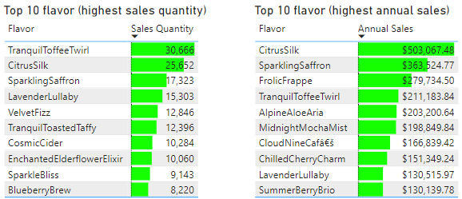
Top 10 flavor (highest sales)
Frolic Frappe is also not the product with the highest quantity of sales. However, it holds the third position as a significant contributor to the company's revenue.
Most of the products that make it into the top 10 as major revenue contributors for the company do not appear in the top 10 in terms of quantity of sales.
Evaluation in the marketing strategy to boost sales for some products such as Frolic Frappe, Tranquill Toffee Twirl, and Alpine Aloe Aria.

Slide 20
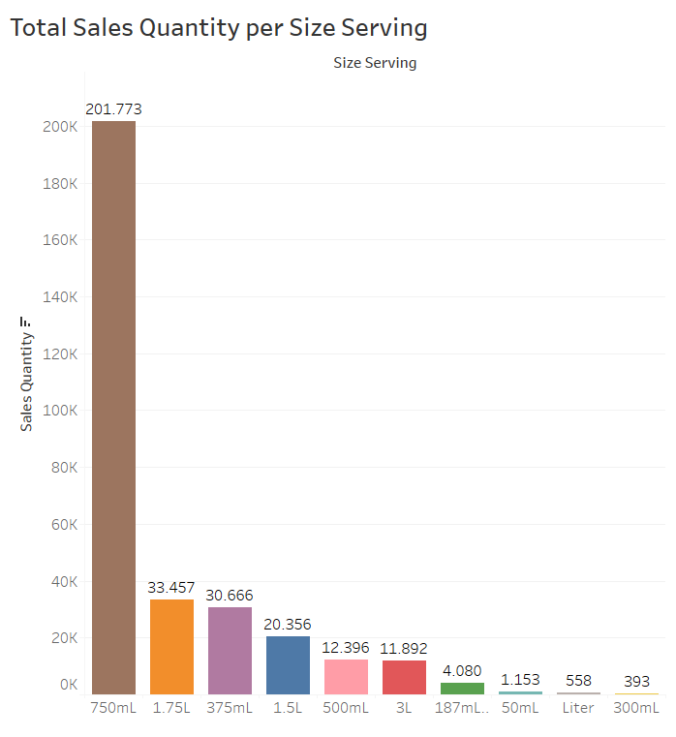
Total Sales per Size Serving
It is clear that the 750ml size is favored, with the highest total purchases among all sizes.
For the 300ml, 1 liter, and 50ml sizes, the continuation of their production needs to be considered.
It's better to focus on just 3 sizes for better cost efficiency in production

Slide 21
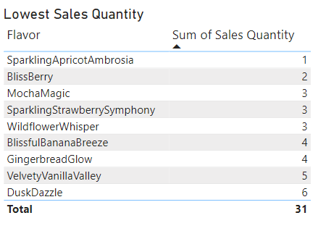
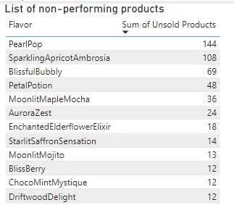
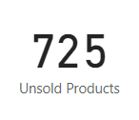
Lowest Sales Quantity
Non-Performing Products
The sustainability of ordering these products needs to be considered.
Need product development, such as flavor modifications.
There are 725 unsold items, with Pearl Pop contributing the most.
The continuation of ordering Pearl Pop and Sparkling Apricot Ambrosia needs to be considered.

Slide 22
Lowest Sales Quantity and Non-Performing Product
For items with the lowest sales and underperforming items, they should be checked back with the vendor
If the items are from a key vendor, it's better to replace them with the best-selling items supplied by that vendor for the next year's order
With some key vendors, cooperation is expected to modify the flavor

Slide 23
Beverage company MANAGINg KEY VENDOR

Slide 24
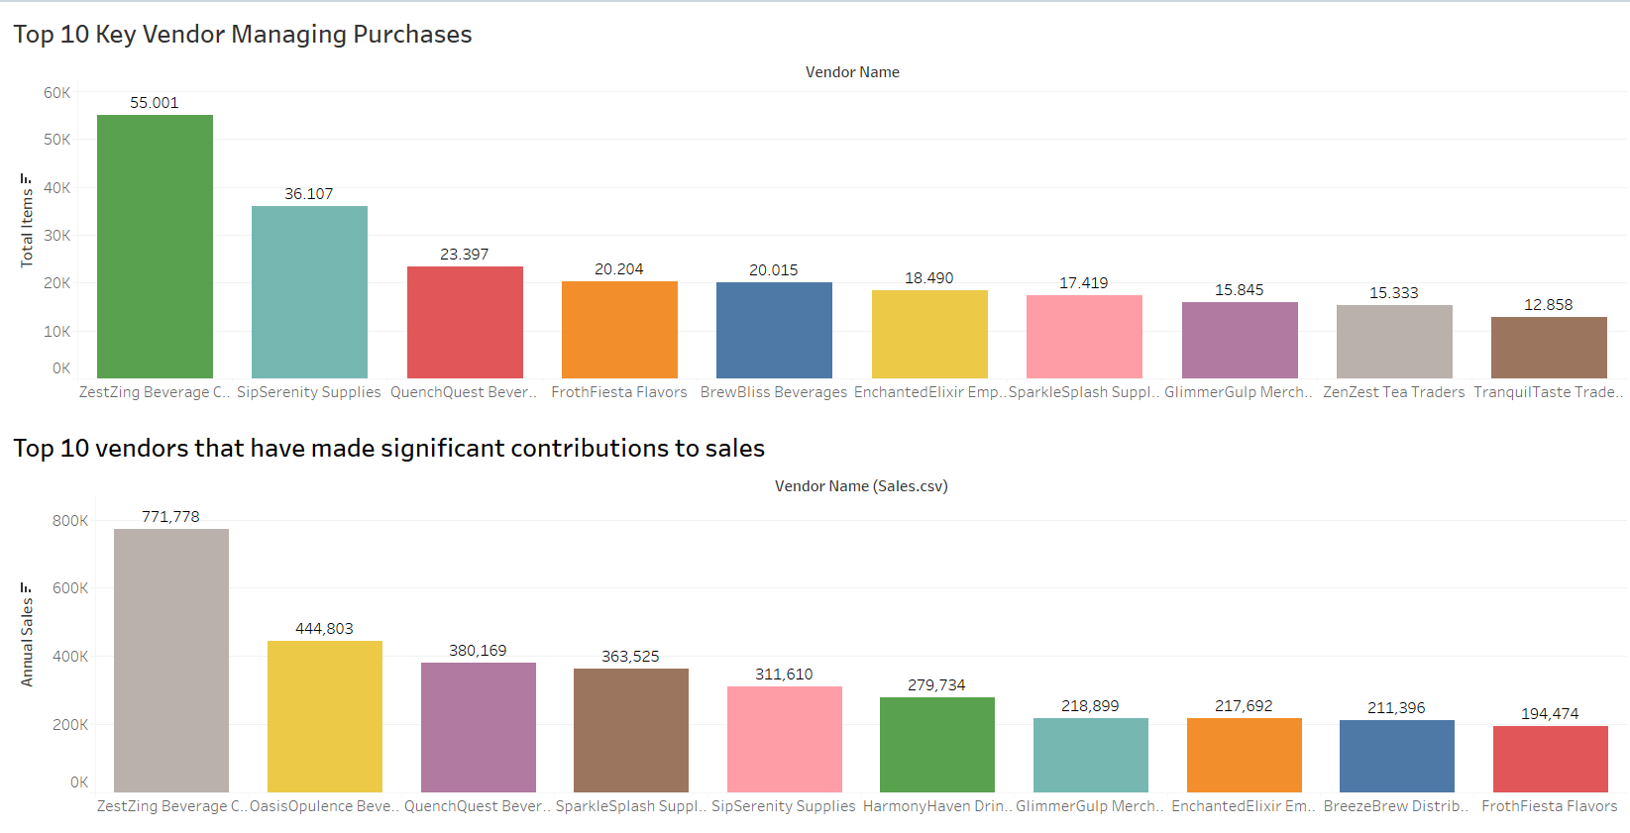

Slide 25
Selecting Key Vendors
ZestZing Beverage Co.
OasisOpulence Beverages
QuenchQuest Beverages
SparkleSplash Suppliers
SipSerenity Supplies
HarmonyHaven Drinks
GlimmerGulp Merchants
EnchantedElixir Emporium
BreezeBrew Distributors
FrothFiesta Flavors
BrewBliss Beverages
ZenZest Tea Traders
TranquilTaste Traders
The selection of key vendors is based on the total quantity of items purchased from each vendor and which vendors generate the highest profits
There are 13 key vendor names identified as key vendors out of the 44 vendors used in 2016

Slide 26
Relationship Management with Key Vendors
Selecting the key vendors is essential to enhance future logistics operations, making operations way more effective
It is expected that company leadership will foster strong relationships with these key vendors to ensure smoother business operations
It is hoped that there can be collaboration with key vendors regarding flavor modifications and the addition of new flavors
Since the focus will be on 3 serving sizes, it is better if this can also be communicated with the vendors

Slide 27
CONCLUSION AND RECOMMENDATION

Slide 28
CONCLUSION AND RECOMMENDATION
The inventory item recording is incomplete. There are discrepancies between the calculations I made and the database owned by Beverage Company. There is also data present in the sales data but not in the stock data after purchase. Additionally, there is data with more sales entries than stock data after purchase. If data recording aligns with the Company's business processes, then Ending Inventory should equal Beginning Inventory + Purchases – Sales
Marketing Strategy: Marketing and supply goods for next year can be focused in the stores that are located in Sapphire Shores, Cypress Springs, and Willowfield. Maximizing the sales of Frolic Frappe, Tranquill Toffee Twirl, and Alpine Aloe Aria products. Maximizing sales with 750ml-sized products.
Product Development: For products with low sales, such as Sparkling Apricot Ambrosia and Bliss Berry, flavor modifications are needed. It's better to focus on just 3 size servings for better cost efficiency in production.
There are 725 unsold items. The least popular flavors are Pearl Pop and Sparkling Apricot Ambrosia. The continuation of ordering Pearl Pop and Sparkling Apricot Ambrosia needs to be considered and also flavor modifications are needed with the key vendors.
There are 13 key vendor names identified as key vendors out of the 44 vendors used in 2016. It is expected that company leadership will foster strong relationships with these key vendors to ensure smoother business operations. It is hoped that there can be collaboration with key vendors regarding flavor modifications, the addition of new flavors, and size serving modifications.

Slide 29
THANK YOU

